Slide 1
Adventure of Xiaozhang
小张求职记
HE Weiyuan 55338942
CAI Yanhuan 55474896
CHEN Dantong 40089057
ZHANG Chuhan 55467217
2018.11.28

Slide 2


Introduction
LOVE
MONEY
Xiaozhang —— a postgraduate student looking for jobs.
She went to BOSS直聘, a recuitment website, to find a suitable operation position.
Notes:
47s

Slide 3
Research Question
What are the factors that would affect the salary of operation position?
Is there any correlation between salary and to what extent the job requirements related with data？
RQ
Notes:
20s

Slide 4
Method - Data source
Web selection
Beijing
https://www.zhipin.com/job_detail/?query=%E8%BF%90%E8%90%A5&scity=101010100&industry=&position=
51job
拉勾网
智联招聘
BOSS直聘
Shanghai
https://www.zhipin.com/job_detail/?query=%E8%BF%90%E8%90%A5&scity=101020100&industry=&position=
Guangzhou
well structured info
uniformed info
has classified labels
easy scrapping comparing to 拉勾
https://www.zhipin.com/job_detail/?query=%E8%BF%90%E8%90%A5&scity=101280100&industry=&position=
Shenzhen
https://www.zhipin.com/job_detail/?query=%E8%BF%90%E8%90%A5&scity=101280600&industry=&position=

Slide 5
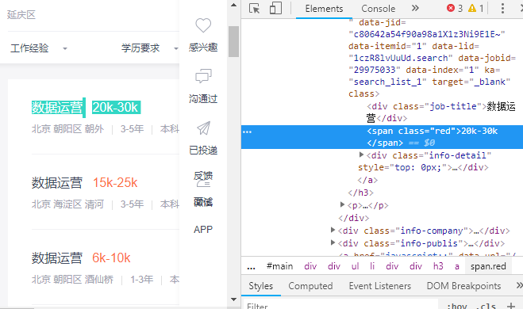
Method - Variables
Dependent Varibale
Independent Varibales
Salary
01
Company type
02
Company size
03
City
04
Education
05
Required experience
06
To what extent the job related to data

Slide 6
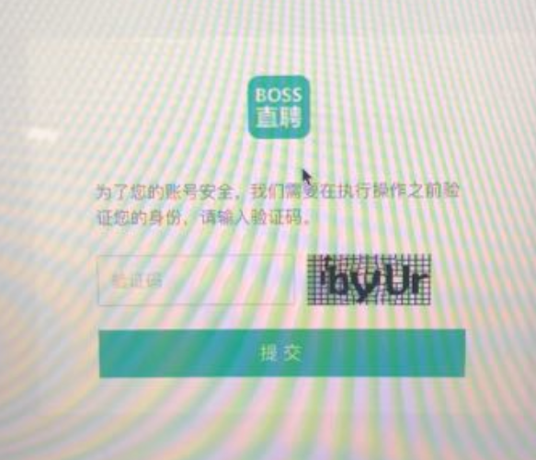

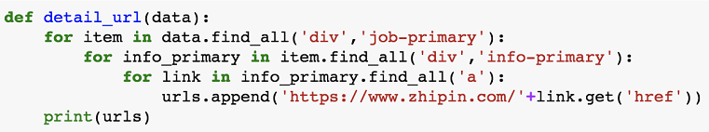
Method - Procedure
Scraping procedure
beautifulsoup — url
find ‘div’ step by step → get ‘href’
xpath — scrap contents in detailed page.
Packages
requests
BeautifulSoup
lxml
Difficulty
Anti-scrapping
Stored format
CSV (1227 pieces of data)

Slide 7
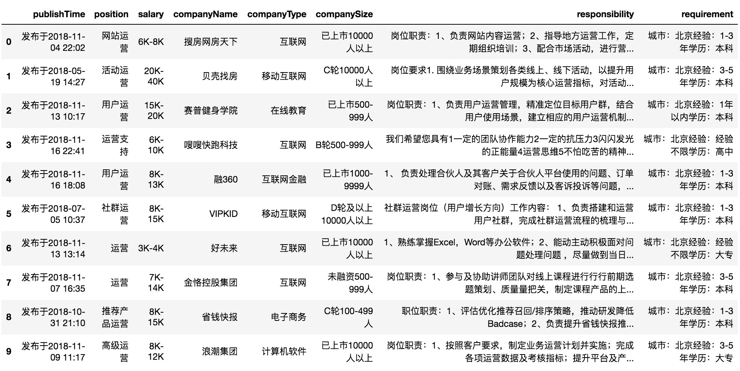
Method - Procudre - Raw data

Slide 8
Method - Data processing
Numeric values
Processing
Text
Processing
Text
Processing
Turn the attribute of “salary” into numeric and average it
Split 3 items(city, experience, education) in “requirement” into 3 separated column
Filter repeated item (internship info & unreadable info) — 1168 pieces of data

Slide 9
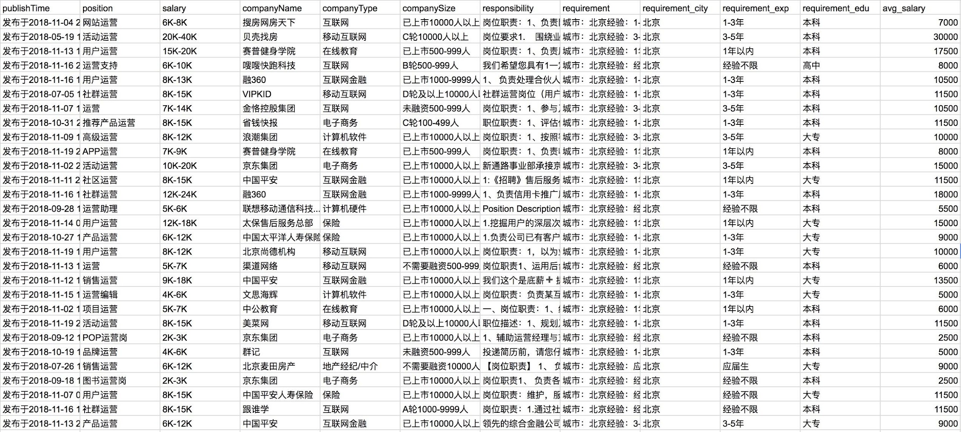
Method - Data processing - Cleaned data

Slide 10
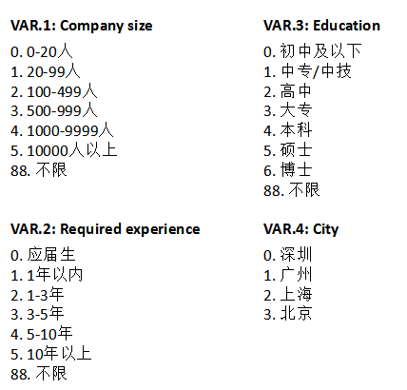
Code book

Slide 11
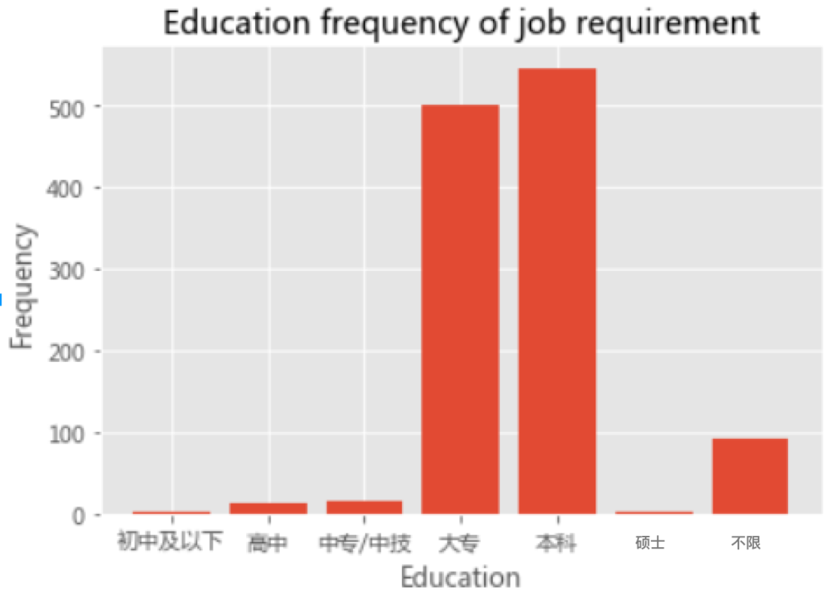
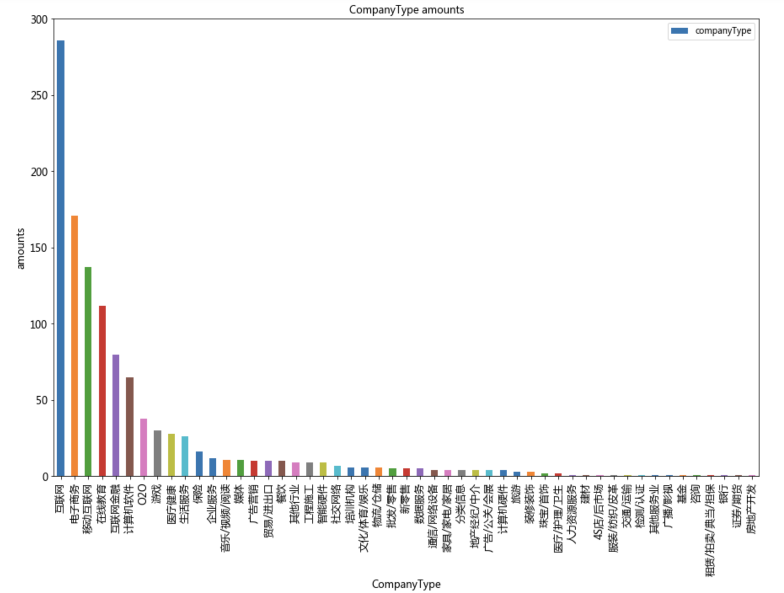
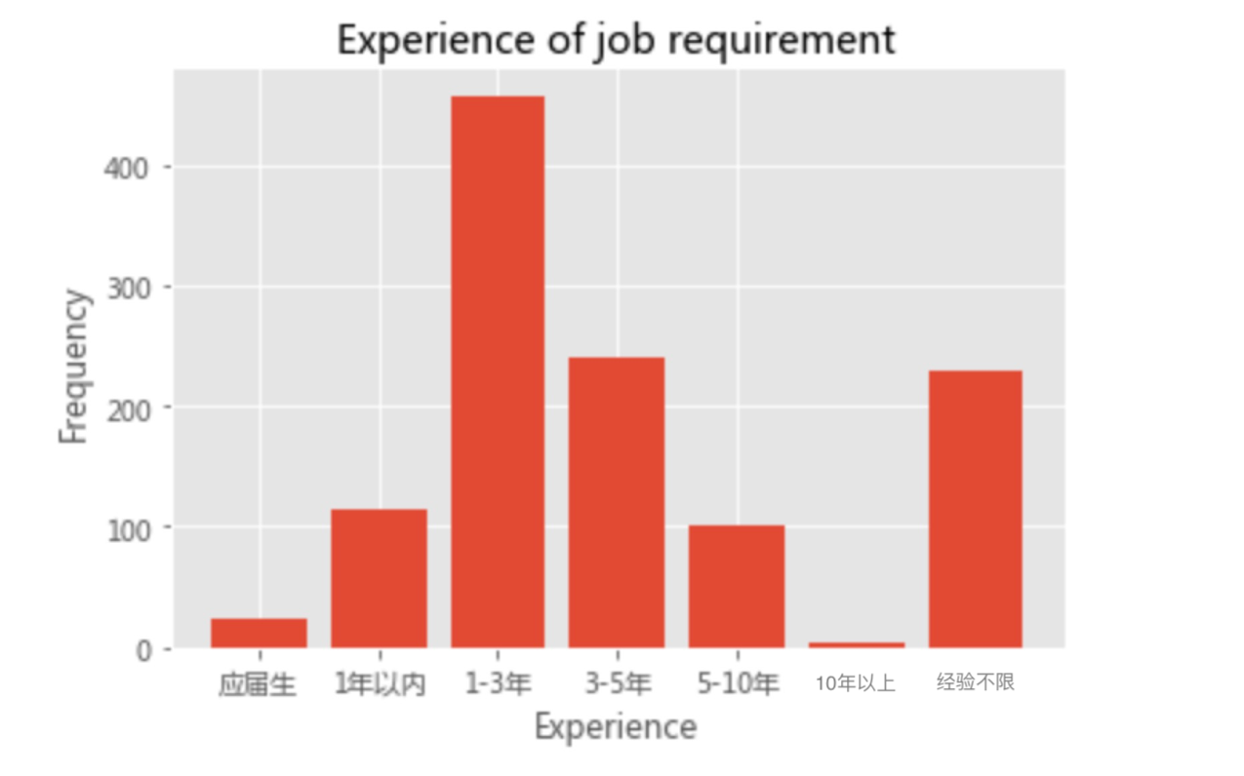
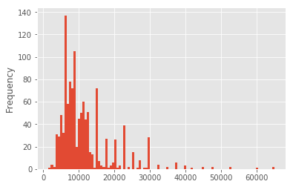
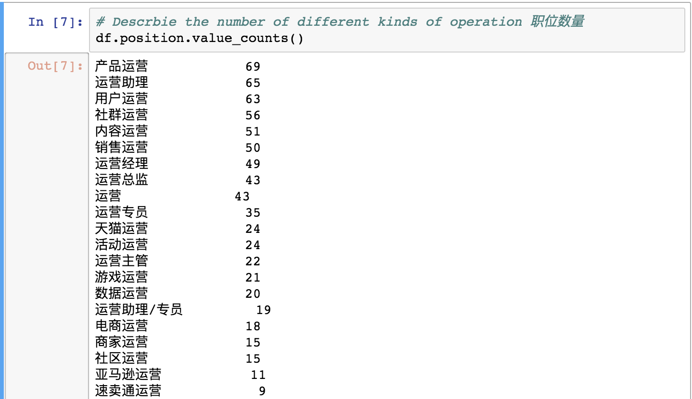

Method - Result

Slide 12
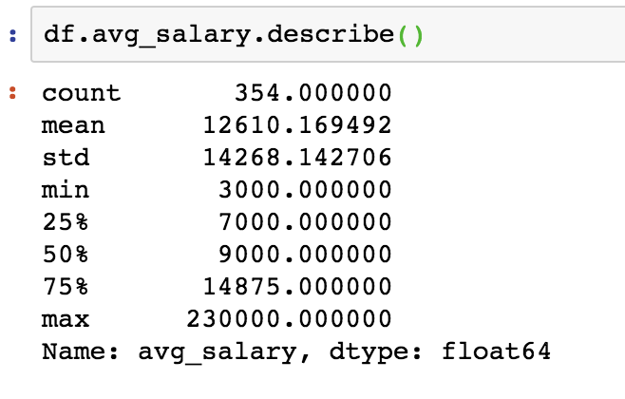
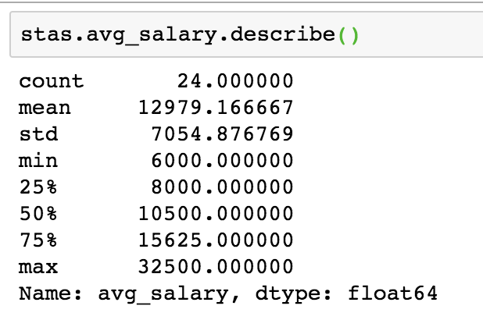
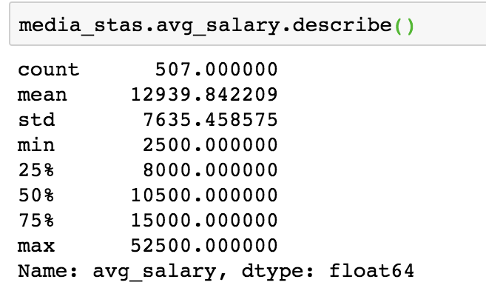
Method - Result
Average salary of operation which includes the word “data” in position name
Average salary of operation which includes the word “data” in position's responsibility
Average salary of operation in all city

Slide 13
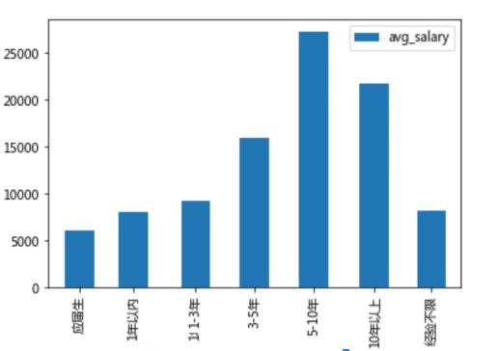
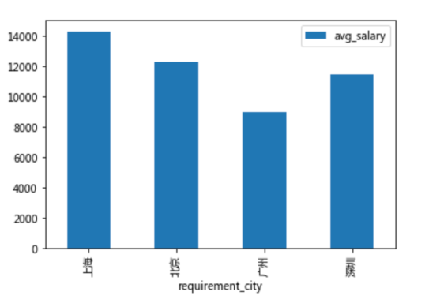
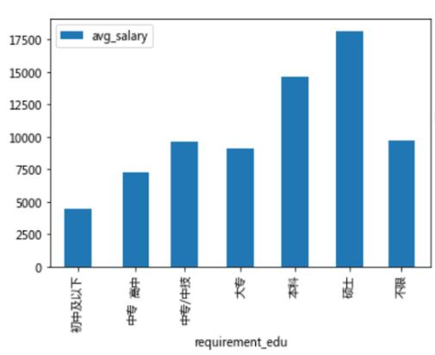
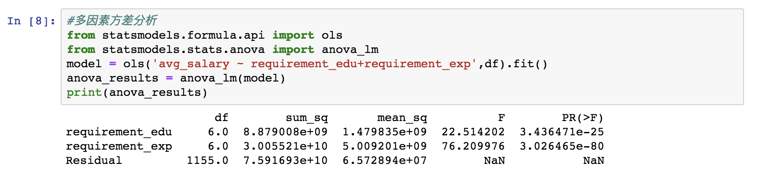
Result

Slide 14
Result
Experience
Education
1 year or more
Bachelor , master will be better
RQ
Industry
Ability
Internet is a good choice
Comprehensive abilities, within which data ability is important

Slide 15

At the end ...

Slide 16
Thanks.

